Slide 1
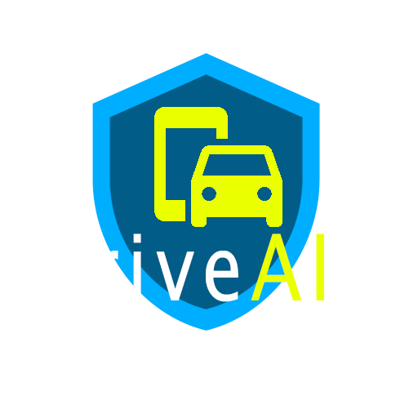

By
Notes:
Hi everyone! We are team Innovate and our product is DriveAid

Slide 2
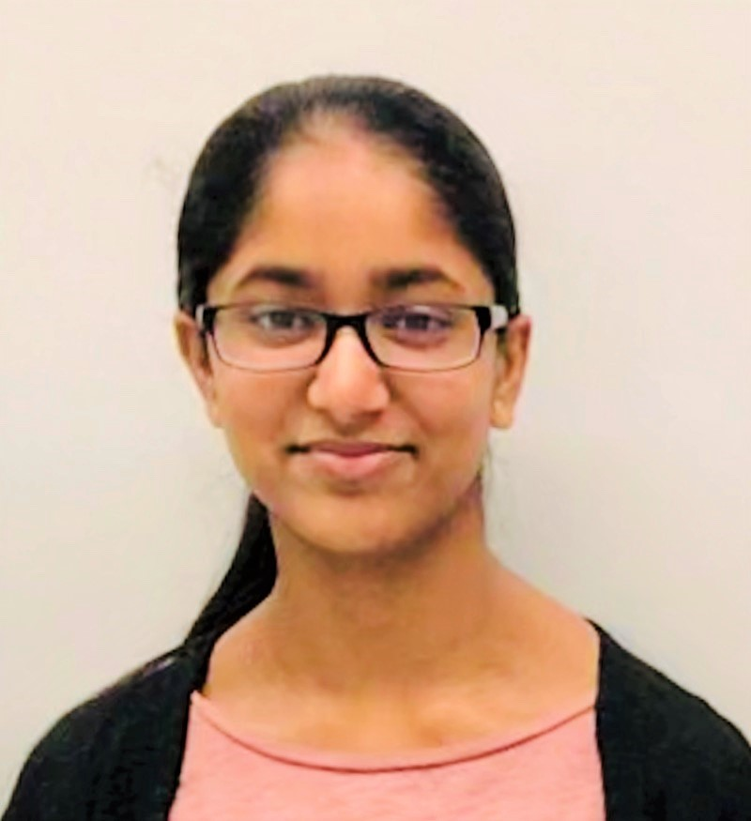
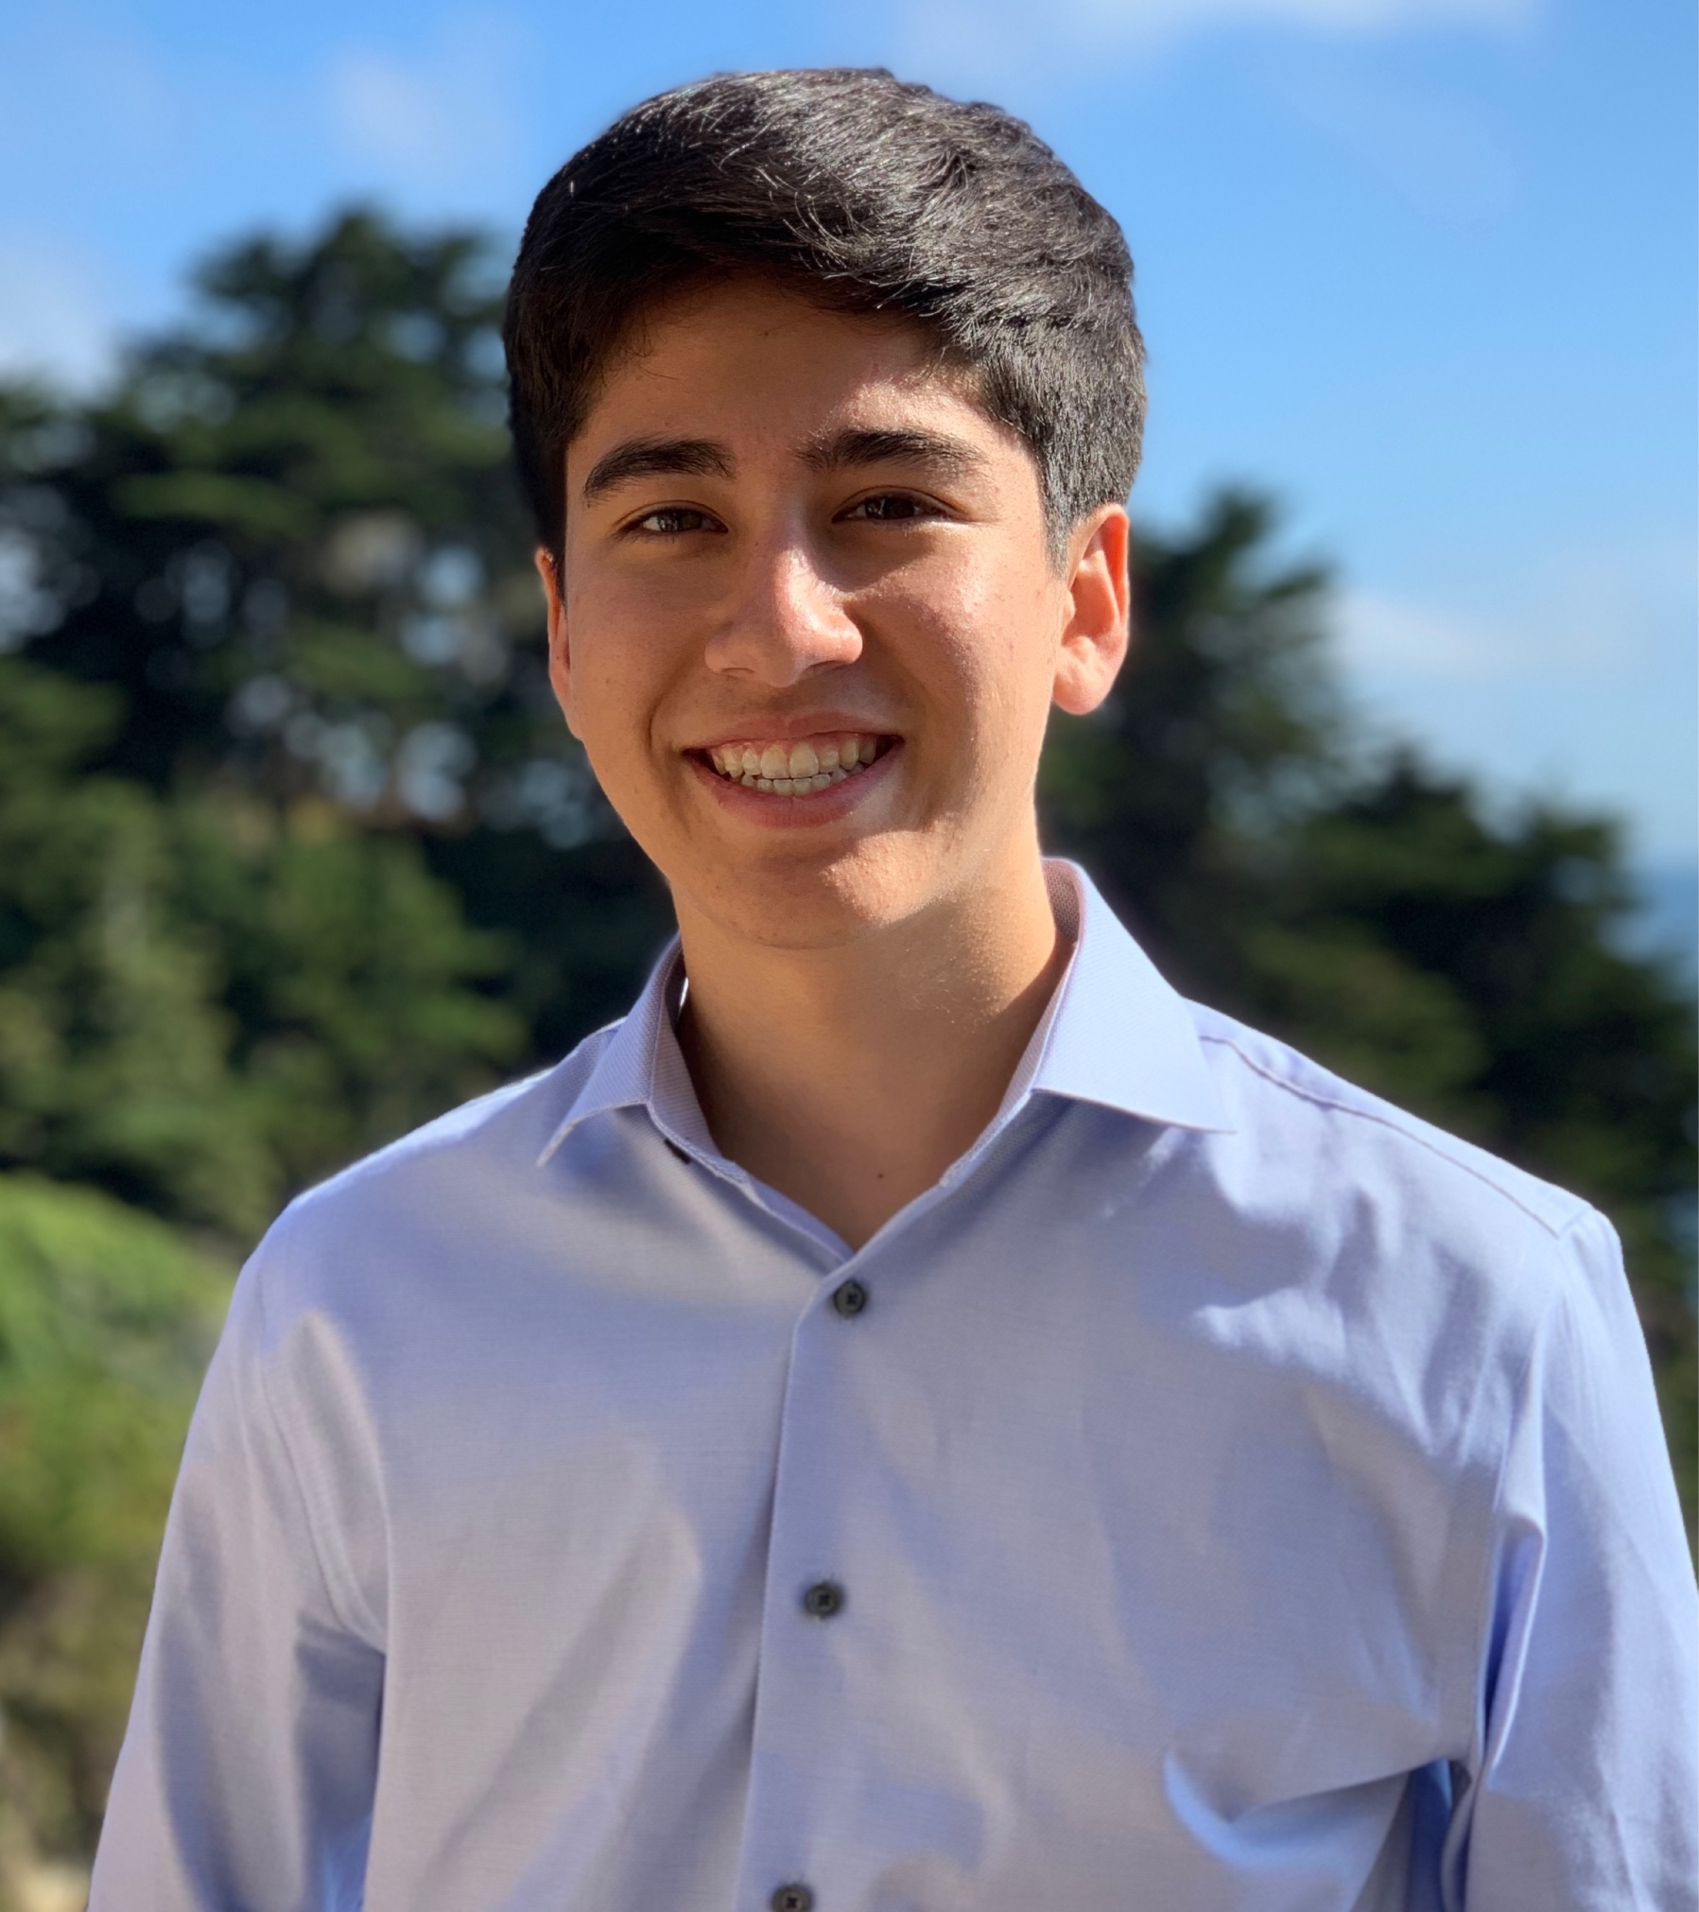

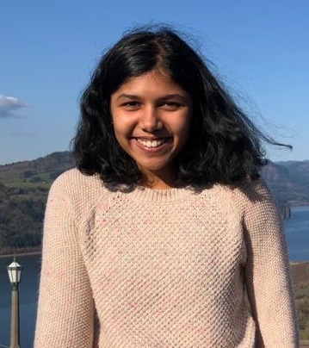
Meet Team InnovAIte!
Image
Anusree Chittineni
High School, Junior
Massachusetts, US
Will Erf
High School Senior
California, US
Image
Jason Jerome
College Senior Virginia, US
Aditi Joshi
College Freshman
Washington, US
Team Mentor: Kunjal Panchal, Grad Student
Notes:
We are a team of four, my name is Aditi
Our team mentor was Kunjal who was an amazing resource through Phase 1 as well as the Makeathon

Slide 3
Agenda
1
The Problem
2
Our Solution
3
Competitive Landscape
4
Demo
5
What’s Next?
Notes:
This what our agenda will look like today. First we will explain our problem, outline the solution and end with a demo and whats next
Aditi

Slide 4

Meet Sophie!
Am I really a good driver?
Notes:
Meet Sophie! Sophie turned 16 last year. Now that’s a big deal because that meant she could start drivers ed. But wait last year was when the pandemic started. How did Sophie do drivers ed? Well you see, Sophie got to do drivers Ed online. Great, right? But what about her on roads, she can't do those online? No but the state reduced the requirements so she could still get her license without doing them. worrying right! Some states like Georgia and Florida even waived the final road test requirement. Now what if I told you hundreds of thousands of teens got their license under these reduced requirements. And what if I told you, I’m one of those teens and Sophie’s story is really my story. This fact signifies the reality of this problem. After going through this experience I’m worried about my driving skills. And i’m not the only teen that’s worried. (last line)
Anusree

Slide 5
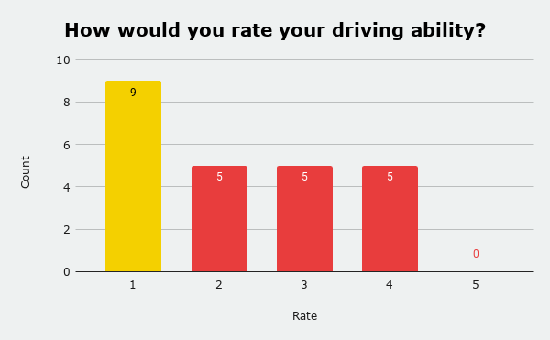
48
Responses
22
Teens
Teens who took Drivers Ed after the start of the pandemic rated themselves lower than those who took it pre-pandemic.
(InnovAIte customer survey, March 16, 2021)
Notes:
We surveyed 48 Teens and Parents to see what their thoughts were on Teen driving. Of those 48 people, 22 were teens. When asked to rate their driving ability on a scale of 1-5, we had some surprising results. Majority of teens rated their driving ability as a 1 and no one gave themselves a 5. Upon further questioning, we came to the conclusion that teens that took drivers ed after the start of the pandemic rated themselves lower than those who took it pre-pandemic. Meaning teens who had the decreased requirements are not as confident in their driving abilities. And that’s not the only thing concerning people about teen driving (last line)
Anusree

Slide 6

Distracted Driving
Lack of Experience
Texting
Adults
Adults
79%
58%
71%
Distracted Driving
Lack of Experience
Indecisiveness
Teens
Teens
58%
63%
67%
Notes:
We asked respondents to tell us what worries them about teen driving. Both parents and teens listed distracted driving and lack of experience as two of their top concerns. In addition parents are worried about texting, while teens are most worried about indecisiveness, a causation of stress for them when driving. All these concerns led us to wonder how we could use safety systems to improve teen driver education as to create better driving habits and safer roads. (last line)

Slide 7
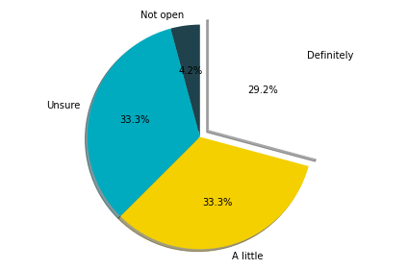
Thoughts on Safety Systems
“Still we need more efficient tools to keep safety for everyone ”
“All for it if they are voluntary and reduce insurance”
“Seems necessary.”
For Teen Drivers: Would you be open to a safety system that measures your driving ability?
Notes:
And according to our survey, both parents and teens are open to them. With parents stating we need more efficient tools to keep everyone safe and another deeming them necessary. And when it comes to the teens, only 1 out of the 22 teens said they were not open to having a safety system that measures their driving ability. With this information in mind I will now hand it off to Aditi to talk about our solution. (last line)
Anusree

Slide 8
Notes:
Aditi- To address these concerns we created DriveAid, a mobile application that notices driving habits and helps teens develop safe driving patterns

Slide 9
How it Works?
Download Application
Start Drive
Review Drive Summary
Reaches a wide audience
Placement mechanisms available
Consent to review and analyze the drive at the start of a session
Start video recording
Video analyzed frame-by-frame by our dual model system
Review the summary report provided at the end of the drive
Notes:
Aditi
SO how does Drive Aid work?
First a user will download the application, this helps us reach a wide audience, as well as take advantage of placement mechanisms such as phone holders
Next, the user will initiate a drive session by first consenting to the app recording them during the drive.
As the session comes to an end, our dual model system will analyze the video frame-by frame
And generate a report that can be reviewed by the driver
The entire video will be deleted after the creation of the report

Slide 10
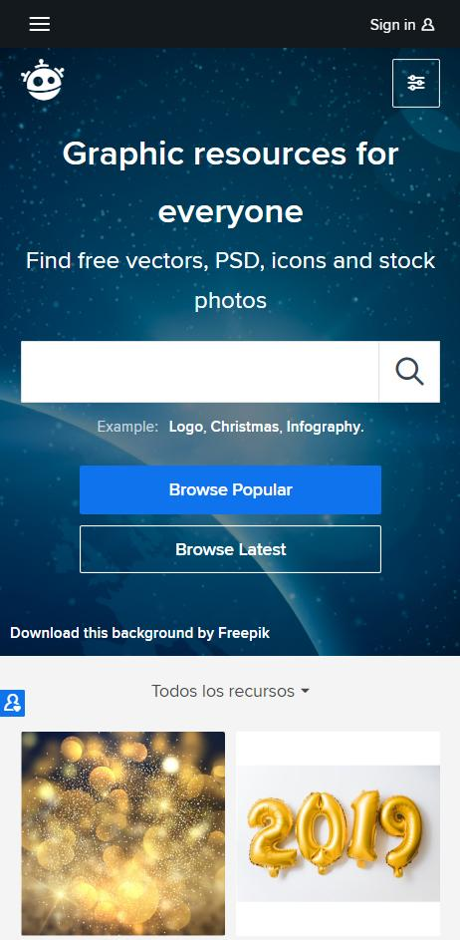
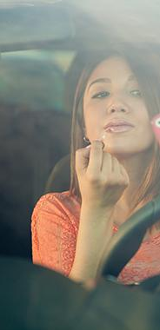
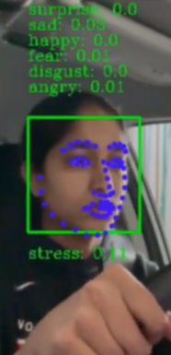
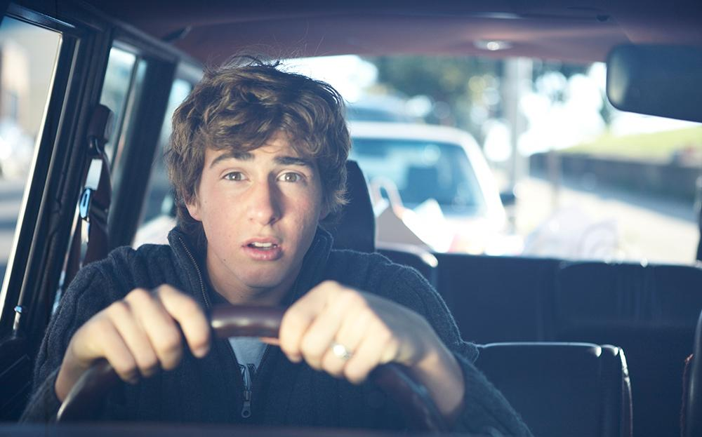
Detects driver stress using emotion detection model
Combined these 2 models detect stress and various gestures
Detects hair/makeup using gesture detection model
Notes:
Specifically our gesture detection model will detect 7 common gestures such as operating center console, drinking or even talking to passengers
We will also recognize 7 different emotions such as when the driver is stressed, happy, sad, or angry

Slide 11
Why it works?
Gesture Recognition
Better Driving Habits
Emotion Recognition
Self-Evaluation
Notes:
Aditi-
So you might ask why does? The emotion recognition model coupled with the gesture detection model helps us get a broader snap shot of the drive to create summary report that we hope inspires self-evaluation and self reflection within teen drivers which will ultimately
lead to better driving habits and safer roads for everyone.

Slide 12
Competitive Landscape
Notes:
Aditi, Next Jason will run you through the competitive landscape

Slide 13




The Competition
Life360
Affectiva
Detects potentially unsafe driving behaviors and shares it with the rest of your family
Detects in-car distractions and emotions of driver and passengers
TrueMotion
Nviso
Detects distracted driving and reports driving score based on level of distraction
Detects driver’s emotional state
Notes:
Jason
Our main competitors that we have identified are Life360, Affectiva, TrueMotion, and Nviso.
These competitors can be broken down into two major groups which includes emotion detection, and gesture detection.
For example, Life360 is an app that can share your location, and driving speed with your friends or family as a safety measure.
While, Affectiva has technology to detect in-cabin distractions and the emotional state of the driver. Their teen driving related products focus mostly on the implementation of parental-controls with real-time alerts when the teen driver violates restrictions placed by their parents (such as maximum number of passenger, loud music, etc). *next slide*

Slide 14
The Numbers:
4.5 rating for Life360 on the Apple App Store
28 million users of Life360 as of March 2020
- Life360
Global emotion detection market is expected to grow to a value of $56 billion by 2024
- Globenewswire
Annualised Monthly Revenue (AMR) in March 2020 was $76.1 million
- Life360
Notes:
Jason
It’s clear that driver safety apps are popular. In addition, the emotion detection market is booming and according to Globenewswire, which is a website that releases articles related to technology and finance, the global emotion detection and recognition market is expected to grow to a value of 56 billion dollars by 2024. *next slide*

Slide 15
Why DriveAID?
No parental-controls or driving restrictions
Accessible to all teens through an app for free
No distracting or real-time analyzing
Large focus on user privacy
“... I don’t like too much oversight”
Notes:
Jason
So, when all these technologies exist, why should you use DriveAID?
Our goal is to make a very accessible, and low-cost entry solution that allow parents to coordinate with their teen to improve their driving ability without restricting their driving, or monitoring their activity.
In our survey teens mentioned they wouldn’t want to be constantly monitored and have an intrusive system. I know I wouldn’t want that either.
Our system has no intrusions and doesn’t report information at real-time which could make the driver more nervous. We also have a focus on user privacy, to make the most ETHICAL solution. All the analyzing is done locally on the device and will never be sent to an outside server.
After every session, when the report is generated, the recording is deleted and only the report will remain which contains no personal information.

Slide 16
Side by Side
 | DriveAID | Life360 | Affectiva
AUDIENCE | Teen Drivers & Parents | Parents | Parents
DETECTION | Emotions & Gestures | Gestures | In-Cabin Environment & Emotions
PURPOSE | Educate & Inform | Regulate | Regulate
Notes:
Jason As you can see, unlike our competitors, we focus on both parents and teens and we aim to better educate and inform teens of their driving ability so that they can improve, rather than be regulated and restricted. *next slide*

Slide 17
Product
Demo
Notes:
Jason
Let’s have a look at what this product might look like: *next slide*

Slide 18
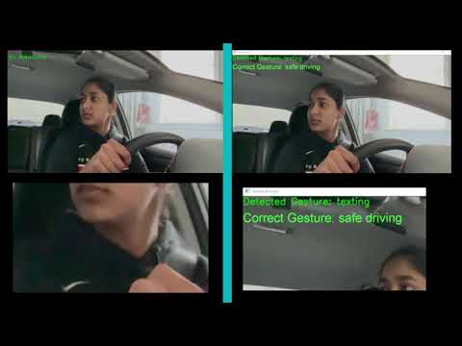


LEFT - Emotion Detection
RIGHT - Gesture
Detection
Notes:
Jason
We have split the demo video into two sections. The left side will feature our emotion detection model, and the right side will feature the gesture detection model.
*play video now*
The emotion detection model that is able to detect all the standard emotions, with a focus on “stress” detection which uses a combination of emotion detection and eyebrow movement detection. This “stress” value can be seen on the bottom-left. Unfortunately, one of the challenges we faced was finding a dataset for front-facing gesture detection. As a result our implementation could not be accurately trained within the time frame of this Makeathon. However, I have edited the video to show what the correct detected gesture is supposed to be so you can see what our goal is with this model. Finally, after the driving session ends, the video is deleted and a report is generated. Will will now show us what the report might look like: *next slide*

Slide 19
Live Dashboard Demo
Notes:
Will

Slide 20
What’s
Next?
Notes:
Will
So what's next for DriveAID? *next slide*

Slide 21
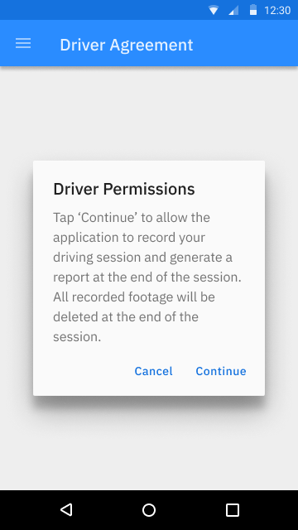
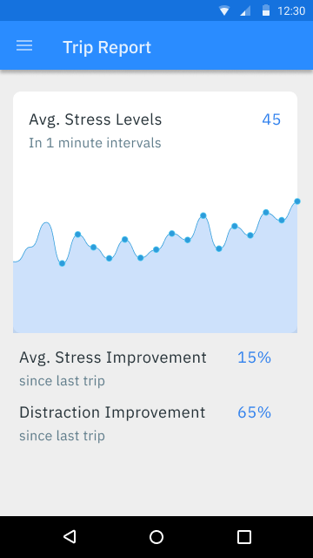
App Interface Mockups
Notes:
Will
We would like to incorporate our idea into a mobile application format. Here are a couple mock-ups we have made to show how the mobile application might look like. The first picture shows our intention to involve the Teen in the learning process by consenting to the driving session. I would like to stress that all of the video and analysis is done locally. All video footage is deleted and only the report is saved. On the right, we have a picture of what the report may look like after a driving session. It would have a timeline of the average stress levels and distractions, and compare it to previous sessions to show driving improvements.

Slide 22
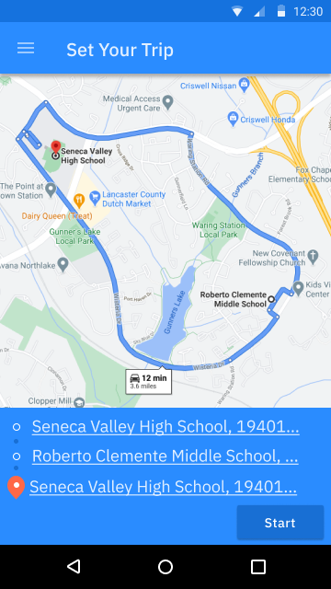
Future Steps
Insurance Companies
GPS
“Teens don’t have money so they should be cheap.”
- Anonymous Teen
“Way too expensive”
- Anonymous Parent
“...those high rates would more negatively affect new/teen drivers in lower socio-economic areas rather than those other areas. “
- Anonymous Adult
Gesture Detection for looking left/right at an intersection or crosswalk
Helps teens to enforce the rules of the road and practice safe driving measures
Notes:
Will
Another concern we identified in our market research was that insurance premiums for teens were very expensive. We could collaborate with insurance companies to lower insurance costs for new drivers by providing driving reports to show the teen’s safe driving habits.
We could also utilize GPS tracking in combination with gesture detection models to check if the teen is employing safe practices at intersections or crosswalks like looking left/right.

Slide 23
Thank You!
This presentation template was created by Slidesgo, including icons by Flaticon, infographics & images by Freepik and illustrations by Stories. This presentation also contains icons from the Google Material Design Icons Library.
Questions?
https://github.com/TeamInnovAIte/InnovAIte
Notes:
Thank you for your time, and thank you to the entire SureStart team for this amazing program. We will now answer any questions you may have.
QnA:
Dataset utilized: Our State Farm dataset from Kaggle consists of over 102,000 images consisting of people of diverse ethnicities and skin tone.
Used a 4 layer CNN
Why couldn’t we find gesture datasets?: We found many gesture detection datasets, especially in vehicles, but we couldn’t find a publicly available front-facing dataset. I believe non-public datasets exist, since Affectiva is capable of doing front-facing gesture detection.
Technologies utilized: OpenCV, Keras, Tensorflow, F.E.R. library (uses HAAR cascade classifier), Dlib library
Types of competition in the driving education market: Parental restriction apps, constant monitoring apps, simulated driving and gamification of driving apps
How we deal with ethical issues: Teen must provide consent at the start of every driving session, recorded videos are deleted at the end of the session, only non-personal data is stored in the report.
Note that an app is more accessible for all income levels compared to integrated hardware
Potential Improvements: front-facing gesture datasets, better hand gesture and pose detection, head tracking to detect if the driver checks left/right at intersections/crosswalks.

